Slide 1

Software Engineering (CS3201) Architectural Design
Avinash

Slide 2

Refinement in Design / Steps in design
High-level architecture (big picture)
This lecture (8.1) deals with high-level architecture primarily
Component-level design (breaking it down)
How components interact, Example: Component diagrams
Database design (where data is stored)
Type of DB (SQL vs. NoSQL), Example: ER diagrams
User interface design
How users interact with system? Examples: wireframes, use cases
API design (how components talk)
Front and back end communication, output: API documentation
Security and performance planning

Slide 3
Brainstorming (more in slide 14)
Is there a tried and tested formula / approach we can use to structure our project? (Architecture patterns)
Single or Distributed? (deployment impacts architecture)
Centralized or Distributed control? (impacts architecture)
How will we document plans? (UML, SDD,…)
Fundamental approach to solve the problem, should we go with monolithic? modular? Microservices?
The word that keeps repeating - 'Architecture'

Slide 4
Setting up the stage... for high level design
What is Software Architecture? What is Architectural Design?
Is it important? (otherwise, I would not be teaching it)
What decisions need to be taken when it comes to software architecture? (slide 14)
What are Architectural patterns? (the keyword is pattern)
What are Application Specific Architectural patterns? (certain patterns are linked to certain applications)
Why so many questions? Can we stop now please!

Slide 5
Architectural Design

Slide 6
Introduction
Architectural design: Organization and structure of a software system
Identifies the main structural components of a system and the relationships between them
Output of Architectural Design process: Architectural model
Even something as dynamic as Agile process aims to identify overall system architecture early into the project. Why? Because changes to Architecture is expensive (students, why is it expensive?)

Slide 7
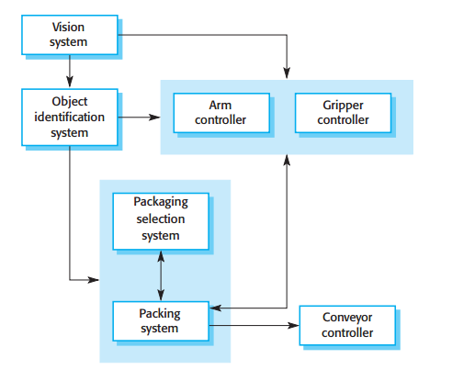
System Architecture: A sample block diagram
Shows the components of a robotic packing system and the links between them
Informal model of architecture
Box = Component (can be decomposed into subcomponents)
Arrow = Direction of data or control signal flow
High-level picture of system structure

Slide 8
System Architecture: Levels of abstraction
Architecture in the small: Architecture of individual (??) programs ("concerned with how an individual program is decomposed into components" - Do not let SOM. confuse you, he means, very likely, an individual software system "this chapter is concerned with program architectures")
Architecture in the large: Architecture of complex enterprise systems that include other systems, programs, and program components ("can consist of or spread over several computers across different companies" - SOM. specifically means distributed systems)
Notes:
What are distributed systems? A distributed system is a collection of independent computers that work together as a single system. These computers (or nodes) communicate over a network to achieve a common goal. Unlike a single system, a distributed system spreads computation, storage, and processing across multiple machines, often improving performance, fault tolerance, and scalability.

Slide 9
System Architecture: Importance
Effects the performance, robustness, distribute-ability and maintainability of a system
Individual components implement functional requirements, but the system architecture influences non-functional requirements
"Non-functional requirements have the most significant effect on system's architecture" (Chen et al, 2013)
You can fulfill the same functional requirements by different architectures, but the non-functional requirements are impacted by different architectures
Notes:
Reliability – an example of a non-functional requirement – this can impact a system's architecture, in that you would want to then have your architecture support portability – and how would you do that? - make it modular – and what is an example of a modular architecture – layered is a good choice across one system (only the bottom layer need to be adjusted as per different platform needs)
Performance – Can have a client server architecture where redundant services are provided by multiple servers, and therefore, performance is faster (if you are gauging performance in terms of speed of execution)

Slide 10
System Architecture: Advantages (Bass et. Al, 2012)
Stakeholder communication: Architecture is a high-level presentation of the system that may be used as a focus for discussion by a range of different stakeholders
System analysis: Making system architecture explicit early in the project leads to system analysis, and decisions have a profound effect on critical (non-functional) requirements like performance, reliability and such
Large-scale reuse: The system architecture is often the same for systems with similar requirements and so can support large-scale software reuse

Slide 11
System Architecture Model: Usage
The block diagram seen earlier does not show relationships between components or the externally visible properties of components (it is an example of a high-level system design)
Two ways in which an architectural model is used:
As a way of encouraging discussions by using a high-level system design
As a way of documenting architecture that has been designed (complete model showing different components, interfaces, connections)

Slide 12
System / Software Architecture definitions (Hans Van Vliet, pg. 281)
An early definition: "The architecture of a software system defines that system in terms of computational components and interactions among those components." (shaw et.al., 1995)
Recent definition: "The software architecture of a program or computing system is the structure or structures of the system, which comprise software elements, the externally visible properties of those elements, and the relationships among them." (Bass et.al., 2003)
Also, software architecture can have different views (just like your system models had different views, based on different perspectives)

Slide 13
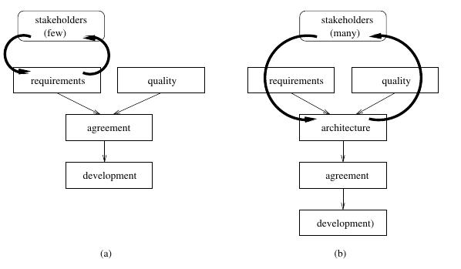
Software Architecture and SDLC (Hans Van Vliet,pg. 283)
Software life cycle a) without and b) with explicit attention to software architecture
In traditional models there is no balancing of functional and quality requirements. Once the functional requirements are agreed upon, development proceeds and it is assumed that quality requirements can be met. If it turns out that the quality requirements cannot be met, the project gets into trouble. Deadlines slip, functionality is skipped, more hardware is bought, etc.
In process models that include a software architecture phase, there is a balancing of functional and quality requirements at an early stage

Slide 14
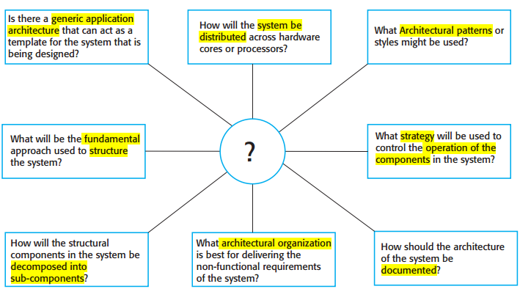
Architectural Design decisions

Slide 15
Architectural views
Two uses of Architectural models:
Encourage discussions on system
Help with detailed system design
Two issues relevant in both uses:
What views and perspectives are useful when designing and documenting a system's architecture?
What notation should be used for describing models?
Impossible to show all relevant architecture information (what components? how they interact? etc.) in one diagram
We will need different perspectives at different times
Therefore, we have multiple views of software architecture

Slide 16
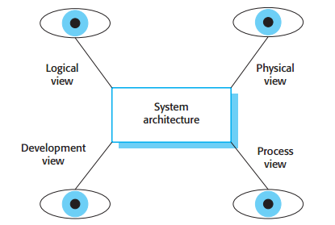
Architectural views (more disturbing than the eye of Sauron?)

Slide 17
Architectural views
4 fundamental architectural views:
Logical view: Shows key abstractions as objects or object classes (helps relate requirements to entities)
Process view: Shows interacting processes at system runtime (gives idea of non-functional characteristics like performance and availability)
Development view: Shows breakdown of software into components
Physical view: Shows system hardware and how software components are distributed across processors
Hofmeister et al. (Hofmeister, Nord, and Soni 2000) suggest the use of similar views but add to this the notion of a conceptual view
Conceptual view: Abstract system view, basis for decomposing high-level requirements into more detailed specifications
Notes:
How is logical view different from development view?
What is conceptual view?

Slide 18
Architectural views
Logical View:
Focus: Functionality
Describes the system's key components, their responsibilities, and interactions from a developer’s perspective.
Often represented using class diagrams, sequence diagrams, or ER diagrams.
Example: In an e-commerce app, this view would show modules like "User Management," "Product Catalog," and "Order Processing."
Development View (Implementation view)
Focus: Code structure and organization
Describes the system's module structure, libraries, and components to help developers manage source code.
Uses package diagrams, component diagrams, or folder structures.
Example: The e-commerce app might have different repositories for frontend, backend, and database schemas. They will be shown as a folder structure where different components are specified.

Slide 19
Architectural views
Process View:
Focus: Runtime behavior and concurrency
Describes how threads, processes, and communication mechanisms work to achieve performance, scalability, and fault tolerance.
Often represented using sequence diagrams, activity diagrams, or deployment diagrams.
Example: How requests from multiple users are handled in parallel in the e-commerce app.
Physical View:
Focus: Infrastructure and hardware
Describes how the software is deployed across servers, networks, or cloud environments.
Uses deployment diagrams or infrastructure diagrams.
Example: The e-commerce app might be deployed on AWS with multiple microservices.

Slide 20
Architectural views
Differing views (I mean opinions) on whether UML should be used for describing/ documenting software architectures
Lange et al., 2006, surveyed and found that UML was applied many a times, in an informal way
However, UML is of most use when documenting an architecture in detail – Somerville, pg. 175
Some researchers (Bass et al., 2012) propose using ADLs to describe architectures – not a very widespread opinion
Informal models, and notations, like UML, remain most used ways of documenting architecture
For more of what Sommerville has to say, read pg. 175; for what I have to say, attend class on 18.3.2026

Slide 21
Architectural Patterns

Slide 22
Introduction
Pattern (English) - "a repeated decorative design", "standard", "model", "arrangement", "structure" (all repeatable)
Pattern as a way of presenting, sharing, reusing knowledge of software systems
Patterns may be described in a standard way using a mixture of narrative description and diagrams
But what is a pattern (in a software/ system sense?)

Slide 23
Architectural Patterns
Abstract description of good practice
Tried and tested (successful) system organizations (on different systems and environments)
Architectural pattern, therefore, "should describe a system organization that has been successful in previous systems"
Should include details of when it is proper to use the pattern, details of strengths and weaknesses of the pattern
Used in high level design
Based on requirements and nature of project, choose an arch. pattern

Slide 24
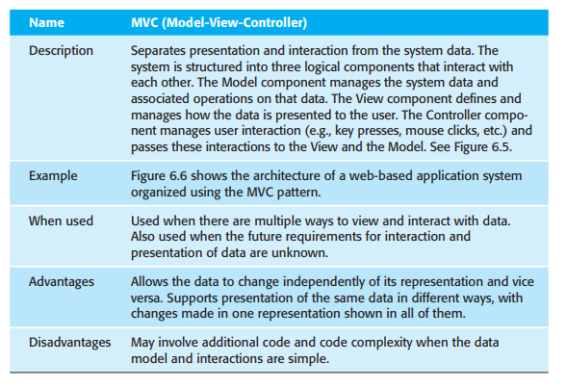
Model-View-Controller: A sample pattern

Slide 25
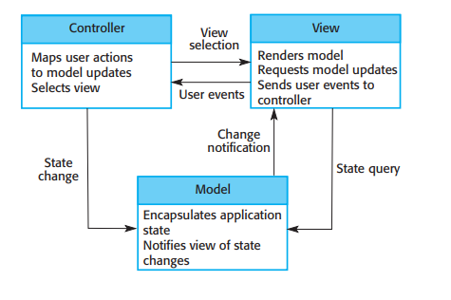
Model-View-Controller: A sample pattern
Organization of a Model-View-Controller system
Note: Use login of a website as an example to explain this architectural pattern.

Slide 26
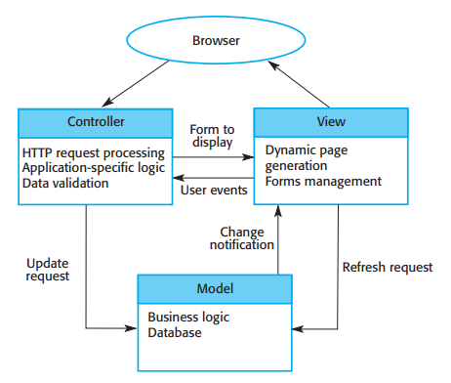
Model-View-Controller: A sample pattern
Web application architecture using the Model-View-Controller pattern

Slide 27
Layered Architecture
Separation and independence - fundamental to architectural design – since they allow changes to be localized
MVC, seen previously, allows separate elements in a system, which can be changed independently
The Layered Architecture is another architectural pattern that allows separation and independence

Slide 28
Layered Architecture
System functionality organized into layers
Each layer relies only (depends) on the layer beneath it
Each layer can communicate with adjacent layers only
Allows incremental development, changeable and portable
If a layer interface changes, only the adjacent layer is affected
Can help localize machine dependencies, therefore portable across platforms
The number of layers is arbitrary

Slide 29
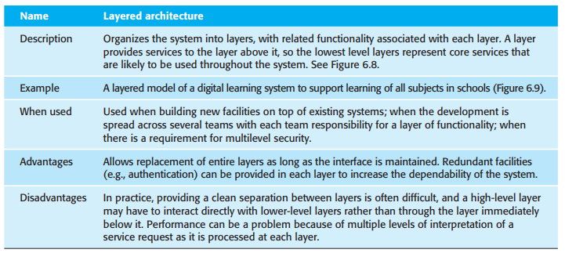
Layered Architecture

Slide 30
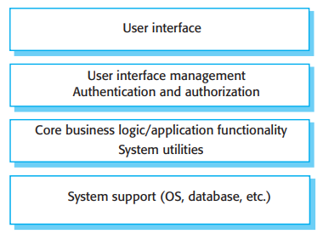
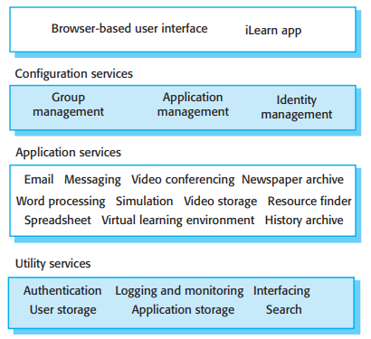
Layered Architecture

Slide 31
Repository Architecture
Describes how a set of interacting components can share data
Systems that use a large amount of data are organized around a shared database or repository
Used by systems where data is generated by one component and used by another
Repository is passive and control the responsibility of components using the repository
"black board" model triggers components when particular data becomes available

Slide 32
Repository Architecture – Simpler words?
Repository Architecture is a software design pattern where:
multiple system components interact with a centralized data store (repository)
The repository acts as a shared knowledge base that different modules access to store, retrieve, and update data
This pattern is useful when multiple subsystems need a common data source and helps in data consistency, integration, and scalability.

Slide 33
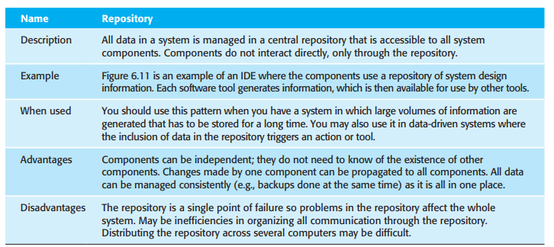
Repository Architecture

Slide 34
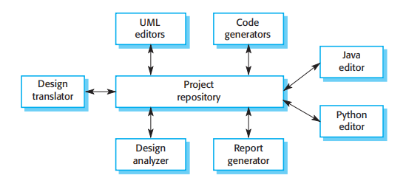
Repository Architecture

Slide 35
Repository Architecture – A more relatable example: GitHub
Central Repository (GitHub Server): Acts as a shared storage where developers push and pull code
Multiple Clients (Developers, Teams, CI/CD Pipelines): Developers interact with the repository using Git commands (clone, commit, push, pull)
Decentralized Contributions: Developers work on local copies (branches), make changes, and synchronize with the central repository
Data Consistency: GitHub ensures that the latest changes are available for all contributors

Slide 36
Client Server Architecture
Commonly used organization for distributed systems
System organized as a set of services (and associated servers), and clients that access and use that services
Major components of this architecture:
Set of servers that offer services to other components
A set of clients that call on the services offered by the servers
A network that allows the clients to access the servers
Generally considered for distributed, a logical model of independent services can be implemented on a single computer
Again, the important benefit is separation and independence (modularity)

Slide 37
Client Server Architecture
Clients should know available servers (and services) and a way to access them (for eg., RPC using HTTP request-reply protocol)
Server need not keep identity of clients, or number of clients connected
Example:
Multi-user, web-based system for providing film and photograph library
Biggest advantage: It is a distributed architecture

Slide 38
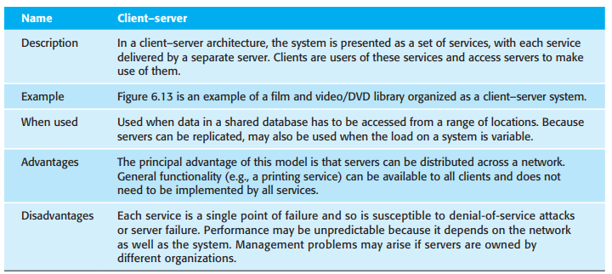
Client Server Architecture

Slide 39
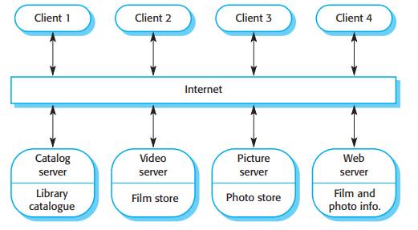
Client Server Architecture

Slide 40
Pipe and Filter Architecture
Model of the runtime organization of a system (where functional transformations process their inputs and produce outputs)
Data moves from one process step to another and is transformed in the process
These process steps may execute sequentially or in parallel
Data can be transformed item by item or in a batch
Name comes from unix where processes can be linked using pipes
A variant of this architecture was used since computers were first used for automatic data processing – sequential processing of batch data – the classic batch (sequential) processing
Best suited for batch and embedded systems (because of limited user interaction)

Slide 41
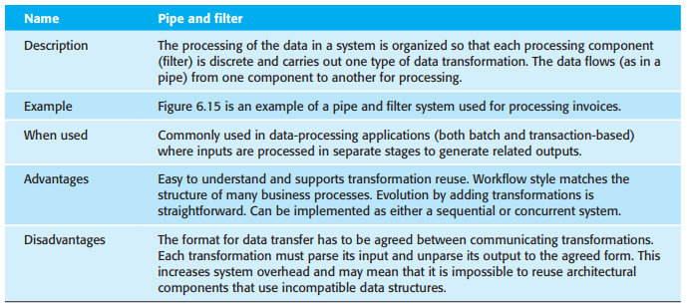
Pipe and Filter Architecture

Slide 42
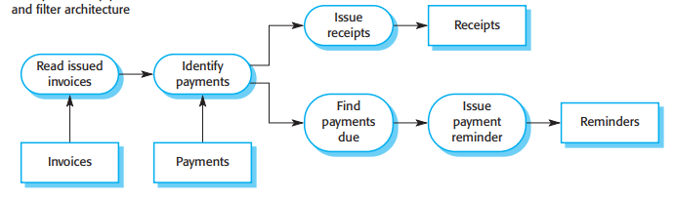
Pipe and Filter Architecture

Slide 43
Various patterns have overlapping features, how do I differentiate? T.T
Feature | MVC | Client Server | Layered
Purpose | Separates UI (Views), Business logic (Controller) and Data to improve maintainability and scalability | Defines how clients and servers interact over a network, sharing data, accessing services to fulfill end goal | Organizes software into layers, each handling a specific responsibility, each layer interacts with adjacent layers only
Focus | Code Structure – Separating frontend (View), backend logic (Controller), and database (Model). | Network Communication – How clients request services from a server over a network. | Application Design – Dividing software into layers (UI, Business Logic, Data) to manage complexity.
Usage | Web & Mobile apps | Distributed systems, cloud applications, web services. | Enterprise systems, banking, security applications.

Slide 44
Various patterns have overlapping features, how do I differentiate? T.T
Feature | MVC | Client Server | Layered
Number of components | 3 | 2 | 3+
Data flow | Controller receives input, updates Model, View gets updated. | Client sends requests to Server, Server responds with data. | Each layer communicates only with adjacent layers.
Example | A web app where the Controller handles login logic, Model stores user data, and View displays the UI. | A banking app where the Client (App/Web) sends a transaction request to the Server (Bank Database). | A banking system with separate layers; Operating systems

Slide 45
When to use which? T.T
Scenario | Best Architecture | Why?
A web application that needs clear separation between frontend UI, business logic, and database. | MVC | Helps manage code efficiently and improves maintainability.
A system where multiple clients (mobile, web, desktop) interact with a central server. | Client-Server | Ensures data consistency across devices and handles network requests.
A large enterprise system (banking, ERP, security) where each part has a specific role. | Layered | Organizes the system into reusable components, where each component or layer has distinct responsibility, and you have several layers of responsibility

Slide 46
Closing thoughts
Other architectures are available:
Microservice based architecture
Peer-to-peer architecture
Event-Driven Architecture
…
Look them up, Sommerville doesn't discuss them, but I will, time permitting

Slide 47
An example: University portal
Functional requirements:
Students can login.
Students can view grades.
Students can view attendance.
Faculty can upload grades.
Admin can manage users.
All these functional requirements can be implemented using any architectural pattern
However, different architecture patterns impact non-functional requirements in different ways

Slide 48
An example: University portal
Consider using the simplest architecture, Monolithic architecture (all modules (login, grades, attendance, admin) run inside one application and one database.)
Non-Functional Requirement | Impact
Performance | Good for small systems because everything runs locally
Scalability | Poor — entire application must scale together
Maintainability | Hard — changing one module may affect others
Reliability | Lower — if the application crashes, the whole portal goes down
Deployment | Simple — only one application to deploy

Slide 49
An example: University portal
Consider MVC (separation of application into three different logical layers, model-view-controller)
Example flow: Student clicks View Grades => Controller => Model => View displays results
Non-Functional Requirement | Impact
Performance | Good for typical web apps; controller mediation may add small overhead
Scalability/ Flexibility | Moderate/ Very flexible – accommodates change in UI without change in logic or data (for example)
Maintainability | High due to separation of UI and business logic
Reliability | Moderate; however much better than monolithic
Deployment | Moderate complexity

Slide 50
An example: University portal
Consider client-server
Example flow: Student app => request grades => server processes => results returned.
Non-Functional Requirement | Impact
Performance | Good for moderate loads; network latency affects response
Scalability | Moderate; server can become bottleneck
Maintainability | Moderate; logic centralized on server
Reliability | Moderate; server failure affects all clients
Deployment | Easier than distributed architectures

Slide 51
An example: University portal
Consider layered (3 layers, presentation for UI, business layer for processing grades and other logic, and data layer to access database)
Example flow: Student UI => Business logic => Database => response returned.
Non-Functional Requirement | Impact
Performance | Slight overhead due to multiple layers
Scalability | Moderate; layers can sometimes scale separately
Maintainability | High due to clear separation of responsibilities
Reliability | Moderate; failure in one layer may impact the application
Deployment | Moderate complexity

Slide 52
An example: University portal
Consider microservices (each module is a separate service, and the services communicate using APIs)
Example flow: Student UI => Business logic => Database => response returned.
Non-Functional Requirement | Impact
Performance | Slight overhead due to network calls
Scalability | Excellent — individual services scale independently
Maintainability | Better — teams can modify services independently
Reliability | Better isolation — failure in one service may not crash others
Deployment | More complex — many services must be managed

Slide 53
Comparison across architectures
Non-Functional Requirement | Monolithic | MVC | Client–Server | Layered | Microservices
Performance | High (local calls inside one application) | Good | Good but affected by network latency | Slight overhead due to multiple layers | Moderate; network communication between services adds overhead
Scalability | Poor (entire system must scale together) | Moderate | Moderate (server can become bottleneck) | Moderate (layers may scale independently) | Excellent (individual services scale independently)
Maintainability | Low for large systems | High due to separation of UI, logic, and data | Moderate (logic centralized in server) | High due to clear separation of responsibilities | Very high (independent services maintained separately)
Reliability | Low (failure can crash whole system) | Moderate | Moderate (server failure affects all clients) | Moderate (layer failure affects system) | High (failure of one service may not affect others)
Deployment | Very simple (single application) | Moderate | Moderate | Moderate | Complex (multiple services and deployments)

